Slide 1
Musical Cubes
“The Three Sided Cube”
Eli Doggart, Owen Krause, Matthew Sweeney

Slide 2

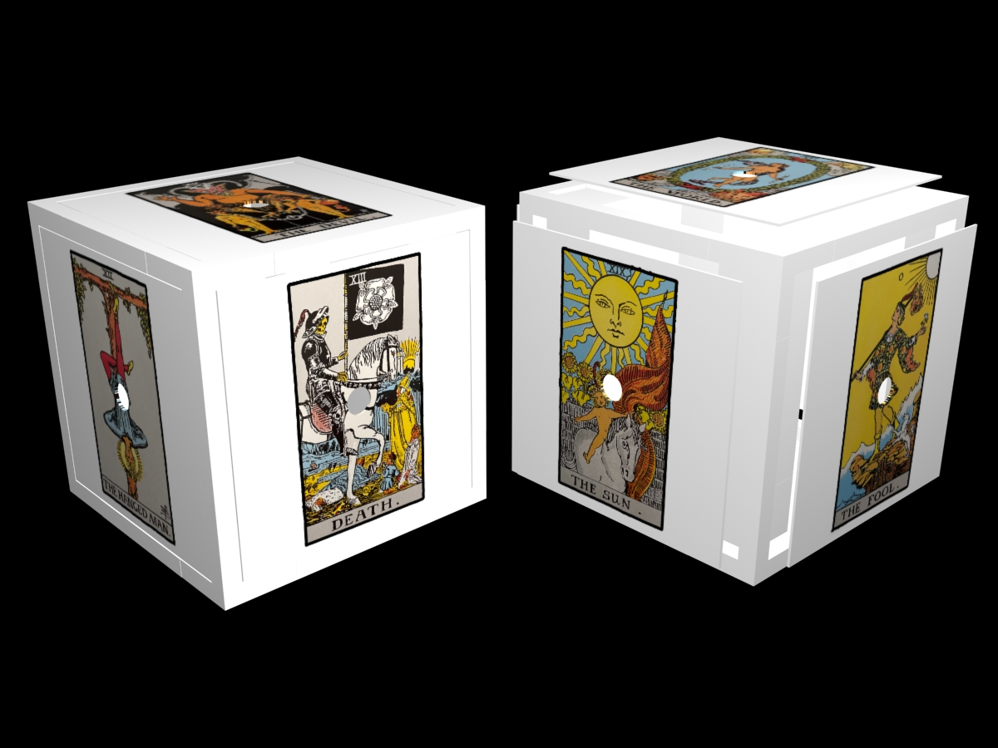
Goal
Design and fabricate a cube that connects to a computer and based on the side it lands on when rolled commands a musical result. Using a combination of BLE and python scripts that interact with the midi bus

Slide 3
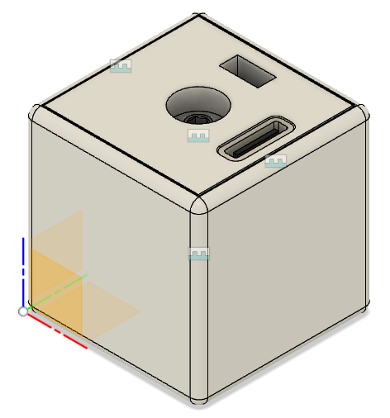
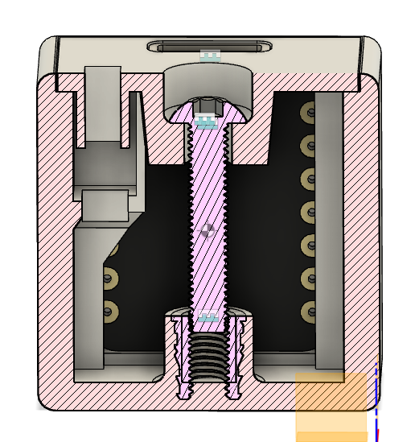
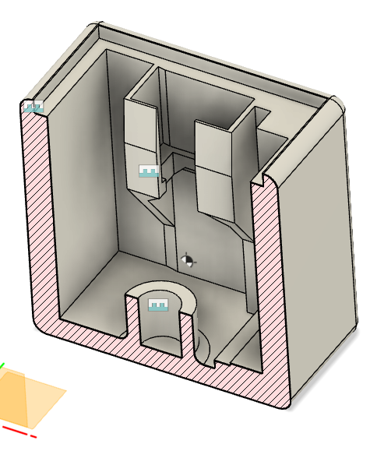
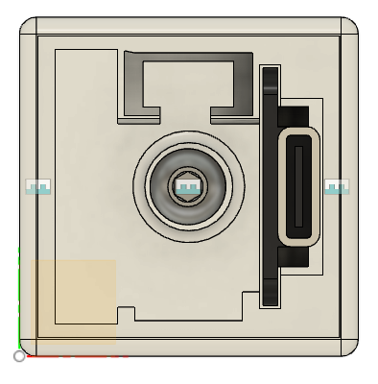
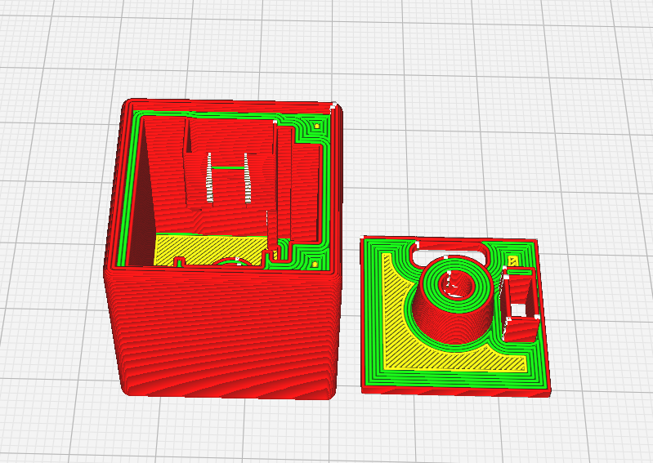
Mechanical Design
Utilized:
Threaded insert
Support free design
Close fit for components
Cable management
Done in Fusion 360
Printed with white PLA

Slide 4
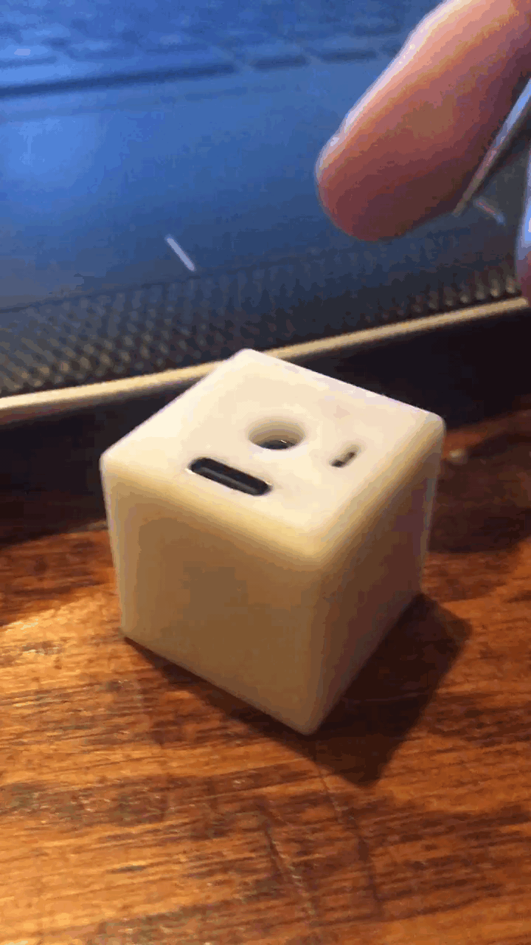

Term Accomplishments
Mechanically Designed and constructed cube
Cube side code sends information across bluetooth of orientation
Computer side code receives data and sends out MIDI

Slide 5
Term Challenges
Working on such a small cube was a challenge in design soldering and assembly
BLE is finicky, it took awhile to get through the BLE roadblocks
The 7 week term flew by

Slide 6
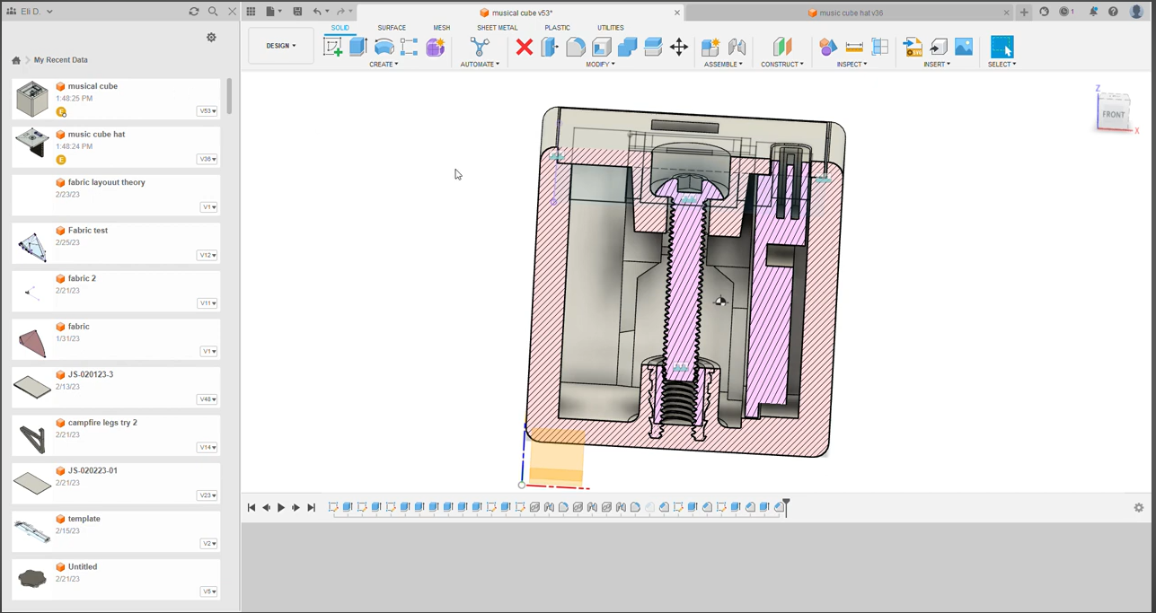
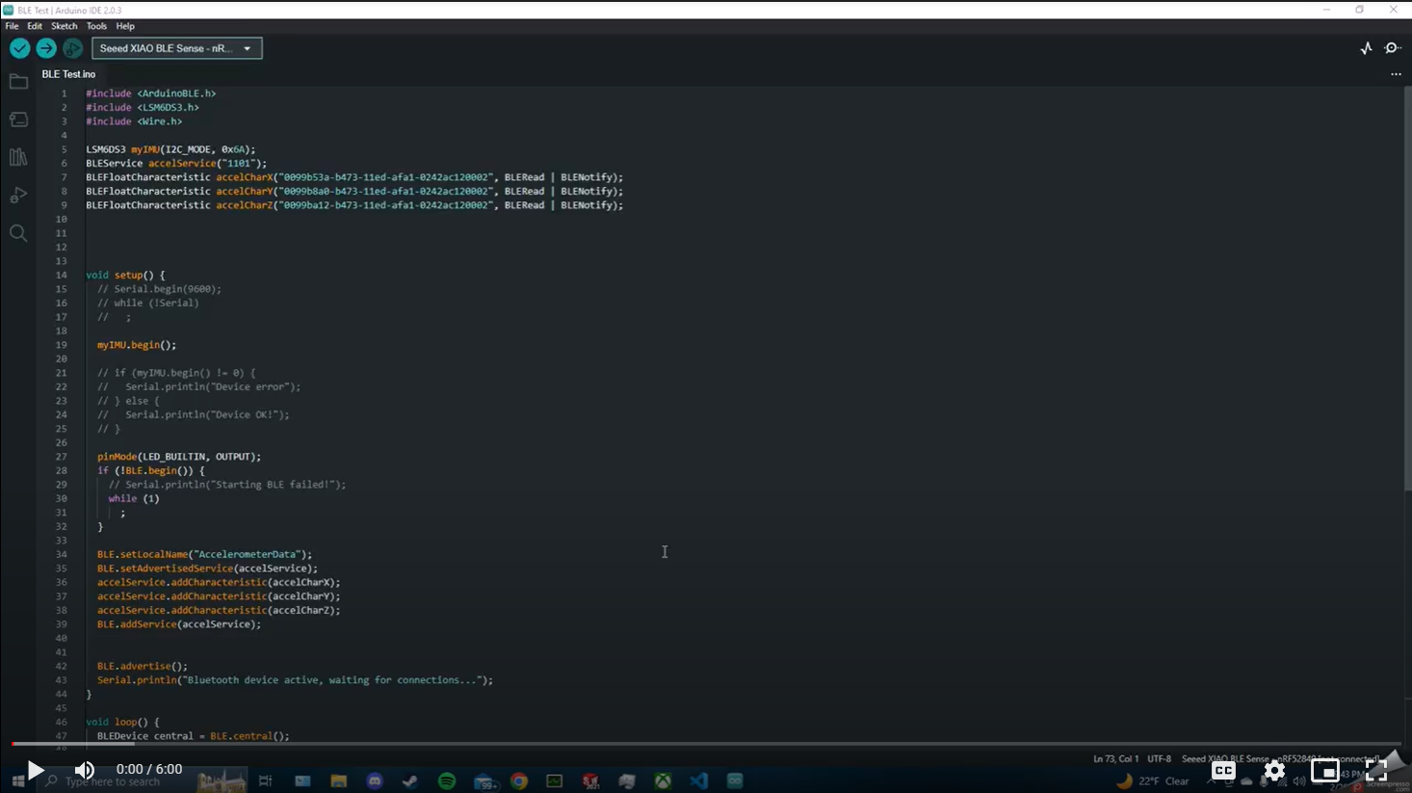
Video Link

Slide 7
Future work
Get multiple cubes working
Find cool use cases for the cubes
Musical games
Ways to randomize music
Writer's block tools
Design the cube to have inset faces for stickers
Switch to bluetooth so that MIDI messages can be sent from the cube

